Slide 1
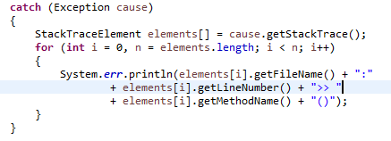
Accessing Stack Trace Information
A stack trace provides information on the execution history of the current thread and lists the names of the classes and methods that were called at the point when the exception occurred.
A stack trace is a useful debugging tool that you'll normally take advantage of when an exception has been thrown.

